Slide 1
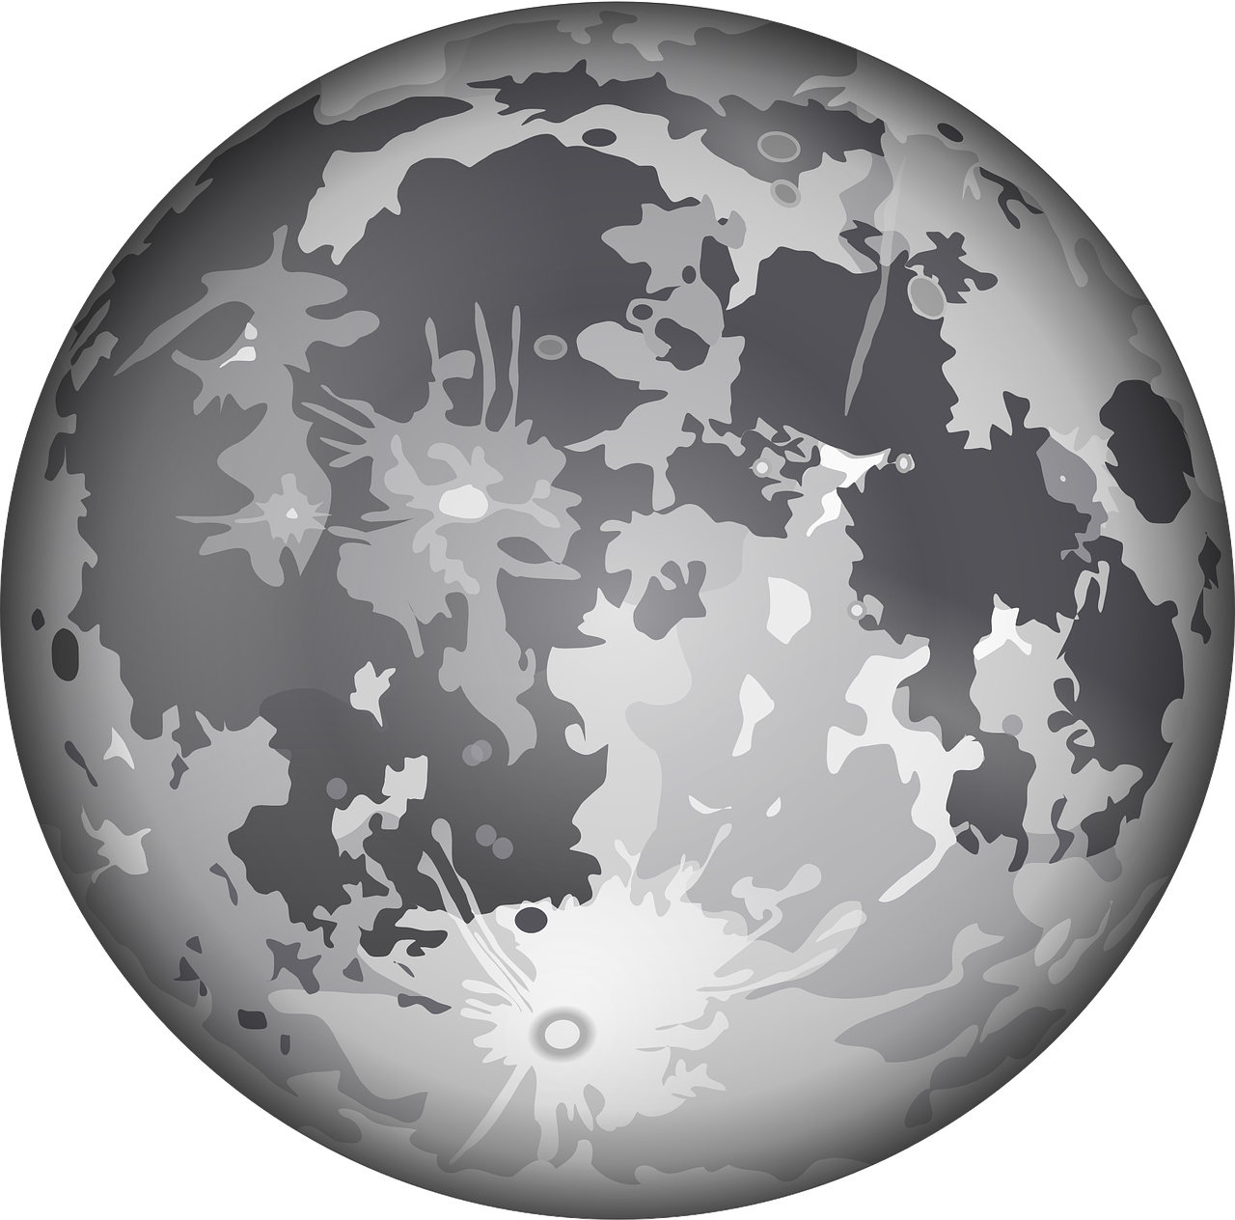
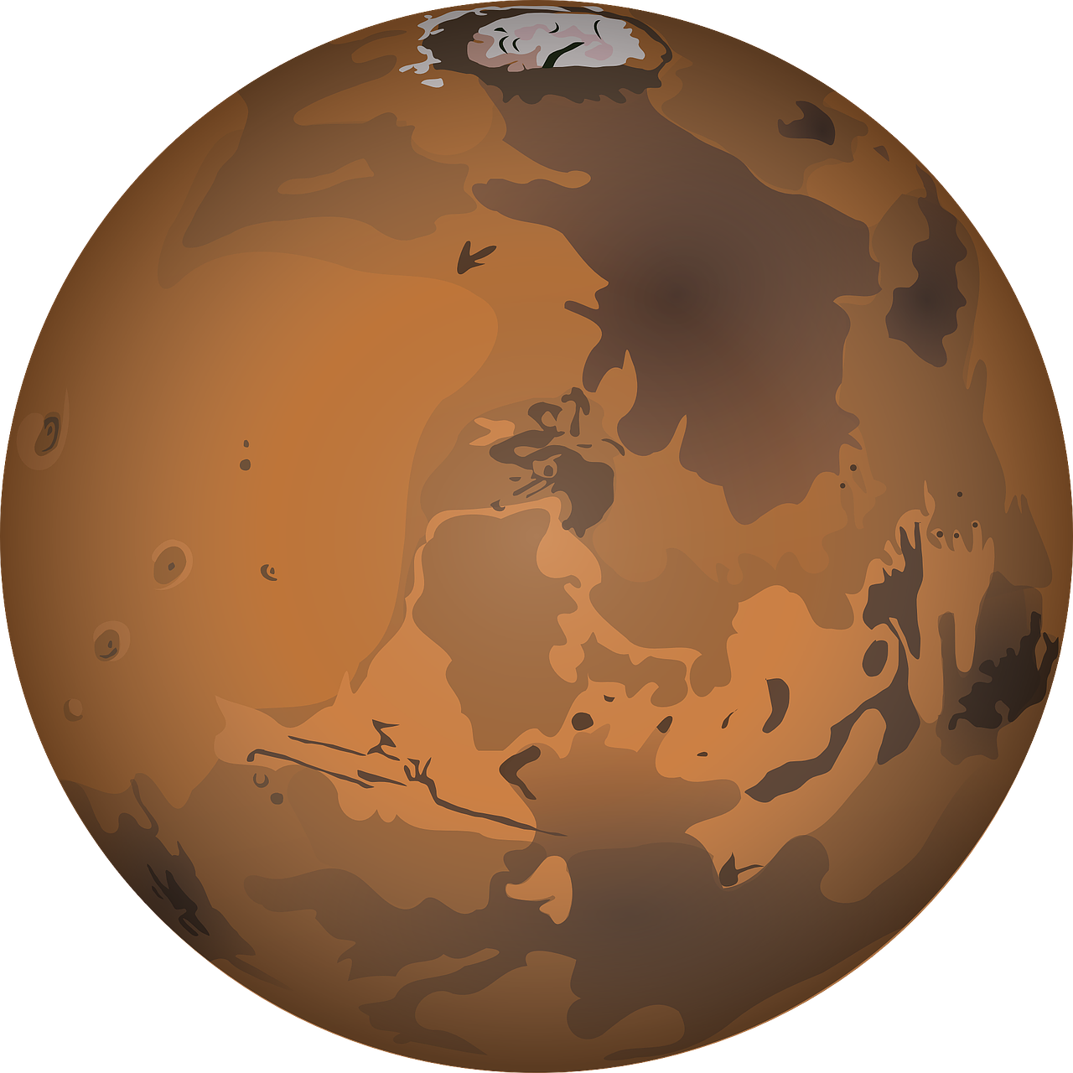

Your planet is running out of energy!! Your people have found two nearby plants Gray-Dust and Brown-Dust
that contain lots of uraseeds [seeds from uranium trees] which your people can efficiently turn into energy. These
planets have different amount of uraseed in different times.

Slide 2


Your people have also made two rockets, black rocket that goes to gray planet and the red rocket to brown planet.
Your task is to choose one of the rockets on a number of times and collect uraseeds from these planets.

Slide 3
Sometimes the rockets will change the planet the visit, when this happened you will be automatically assigned to a rocket for one time. After that you will again choose your rocket

Slide 4
For a number of times, you should choose a rocket which will take you to one of the planets. You should try to collect as much uraseed as you can by trying to choose the rocket that goes to the planet that has the most uraseed.

Slide 5
Choosing rocket
[ Participants thinks on which rocket to choose ]

Slide 6
Choosing rocket
[ Participant chose the red rocket ]

Slide 7
Rocket reaching planets
[ Participant sees where the rockets got ]

Slide 8
Rocket reaching planets
[ Participants sees how much uraseed they got]

Slide 9
Choosing rocket
[ This time the rocket is already chosen ]

Slide 10
Rocket reaching planets
[ Participants sees where the rockets got ]

Slide 11
Rocket reaching planets
[ Participant sees how much uraseed they got ]

Slide 12


Alternative to rockets
Portals
Choose a portal that will take you to another planet
Spinning effect to portals when chosen

Slide 13
ways of showing reward
1)
2)
Small reward
Big reward
Small reward
Big reward

